Slide 1

What is SystemML (in a nutshell)
Presented by:
Niketan Pansare
IBM Research - Almaden
npansar@us.ibm.com
http://systemml.apache.org/
http://www.vldb.org/pvldb/vol9/p1425-boehm.pdf

Slide 2

What is SystemML (in a nutshell)
Provides a R-like language (DML) for data scientists to implement machine learning algorithms
2

Slide 3
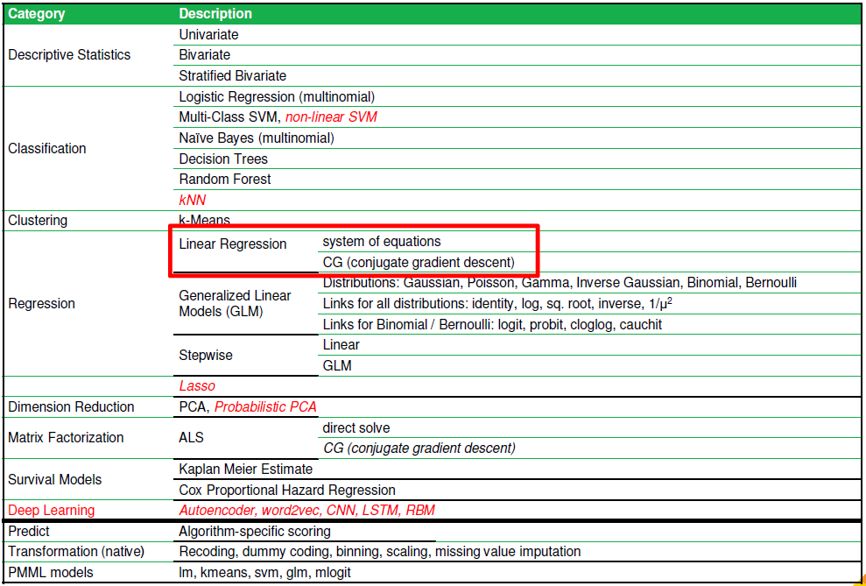
What is SystemML (in a nutshell)
Provides a R-like language (DML) for data scientists to implement machine learning algorithms
Also comes with approx. 20+ algorithms pre-implemented
3

Slide 4




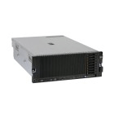
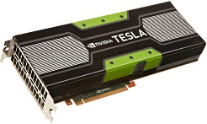
What is SystemML (in a nutshell)
Provides a R-like language (DML) for data scientists to implement machine learning algorithms
Compiles execution plans ranging from single node (scale up) to clusters (scale out on data parallel platforms MapReduce, Spark)
DML Scripts
Language
Compiler
Runtime
In-Memory Single Node (scale-up)
Hadoop or Spark Cluster (scale-out)
since 2012
since 2017
since 2010
since 2015
4

Slide 5
What is SystemML (in a nutshell)
Provides a R-like language (DML) for data scientists to implement machine learning algorithms
Compiles execution plans ranging from single node (scale up) to clusters (scale out on data parallel platforms MapReduce, Spark)
Runs in embeddable, standalone, and cluster (hybrid)
Supports various APIs (Scala/Python/Java)
5

Slide 7
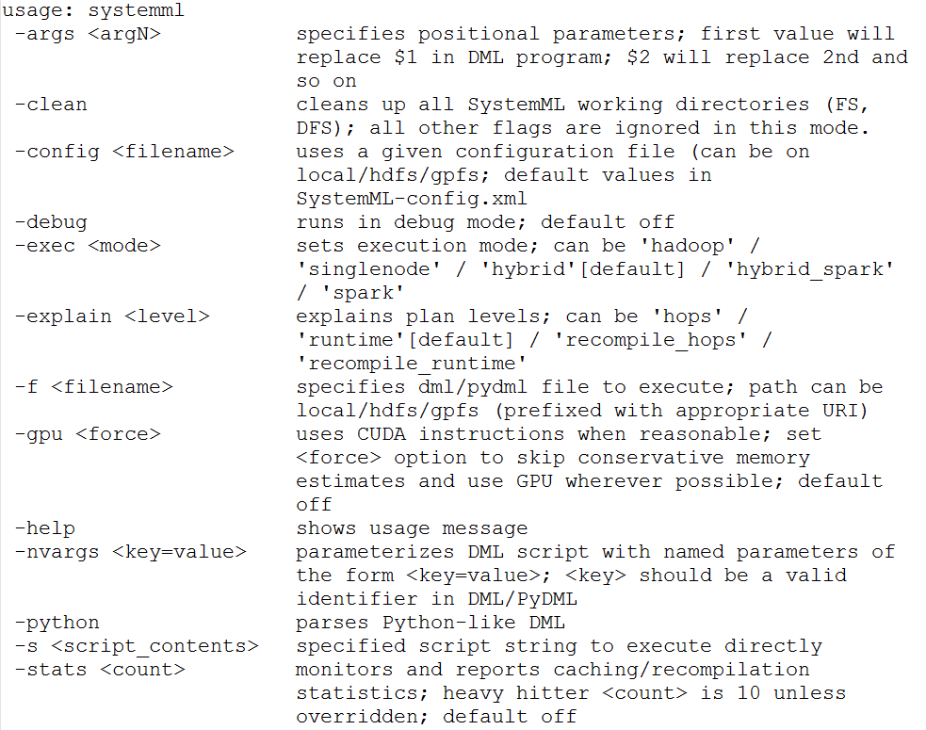
Invoking SystemML
7

Slide 8
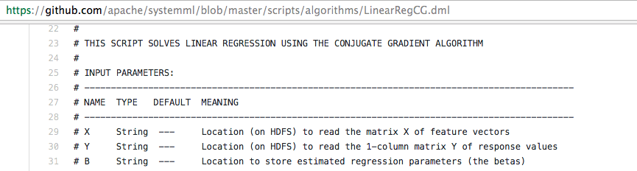
Invoking SystemML
Data on disk/HDFS
In-memory single node
Hadoop
Spark
RDD/DataFrame/NumPy/Scipy
double [][]
8

Slide 9
Invoking SystemML
Data on disk/HDFS
In-memory single node
Java Command Line:
$ java -cp SystemML.jar org.apache.sysml.api.DMLScript \
–f LinearRegCG.dml –exec singlenode –nvargs X=X.mtx Y=Y.mtx B=B.mtx
$ java -cp systemml-1.0.0-standalone.jar org.apache.sysml.api.DMLScript \
–f LinearRegCG.dml –nvargs X=X.mtx Y=Y.mtx B=B.mtx
(Latter command preserves rewrites, but may spawn local MR jobs)
https://github.com/apache/systemml/blob/master/scripts/algorithms/LinearRegCG.dml
9

Slide 10
Invoking SystemML
Data on disk
In-memory single node
Hadoop
Hadoop Command Line:
$ hadoop jar SystemML.jar \
–f LinearRegCG.dml –exec hybrid –nvargs X=X.mtx Y=Y.mtx B=B.mtx
10

Slide 11
Invoking SystemML
Data on disk
In-memory single node
Hadoop
Spark
Spark Command Line:
$ spark-submit --master yarn-client SystemML.jar \
–f LinearRegCG.dml –nvargs X=X.mtx Y=Y.mtx B=B.mtx
11

Slide 12
Invoking SystemML
Data on disk
In-memory single node
Hadoop
Spark
RDD/Dataframe
$ spark-shell --jars SystemML.jar –-driver-memory 3g
import org.apache.sysml.api.mlcontext._ import org.apache.sysml.api.mlcontext.ScriptFactory._ val ml = new MLContext(sc) val X = // ... RDD, DataFrame, etc. val script = dmlFromFile("LinearRegCG.dml").in("X", X)
.in(...).out("B") val b = ml.execute(script).getDataFrame("B")
12

Slide 13
Invoking SystemML
Data on disk
In-memory single node
Hadoop
Spark
RDD/Dataframe/NumPy/SciPy
Python MLContext API
$ pip install systemml
$ pyspark –-driver-memory 3g
from systemml import MLContext, dmlFromFile ml = MLContext(sc) X = // ... RDD, DataFrame, NumPy, Scipy etc. script = dmlFromFile("LinearRegCG.dml").input("X", X)
.input(...).output("B") b = ml.execute(script).getDataFrame("B")
13

Slide 14
Invoking SystemML
Data on disk
In-memory single node
Hadoop
Spark
RDD/Dataframe/NumPy/SciPy
Python MLContext API
MLLearn API
$ pip install systemml
$ pyspark –-driver-memory 3g
from systemml import LinearRegression
train_df = // ... RDD, DF regr = LinearRegression(spark)
regr.fit(train_df) b = regr.predict(test_df)
14

Slide 15
Invoking SystemML
Data on disk
In-memory single node
Hadoop
Spark
RDD/Dataframe/NumPy/SciPy
Python MLContext API
MLLearn API
$ pip install systemml
$ pyspark –-driver-memory 3g
from systemml import LinearRegression
X_train, y_train = // ...NumPy, Scipy regr = LinearRegression(spark)
regr.fit(X_train, y_train) b = regr.predict(X_test)
15

Slide 16
Invoking SystemML
Data on disk
In-memory single node
Hadoop
Spark
RDD/Dataframe/NumPy/SciPy
Python MLContext API
MLLearn API (experimental APIs: Keras2DML, Caffe2DML)
See https://apache.github.io/systemml/deep-learning
$ pip install systemml
$ pyspark –-driver-memory 3g
from systemml import Keras2DML
train_df = // ... RDD, DataFrame sysml_model = Keras2DML(spark, keras_model, …)
sysml_model.fit(train_df) b = sysml_model.predict(test_df)
16

Slide 17
Invoking SystemML
Data on disk
In-memory single node
Hadoop
Spark
RDD/Dataframe/NumPy/SciPy
Python MLContext API
MLLearn API (experimental APIs: Keras2DML, Caffe2DML)
See https://apache.github.io/systemml/deep-learning
$ pip install systemml
$ pyspark –-driver-memory 3g
from systemml import Keras2DML
X_train, y_train = // ... NumPy, Scipy sysml_model = Keras2DML(spark, keras_model, …)
sysml_model.fit(X_train, y_train) b = sysml_model.predict(X_test)
17

Slide 18
Invoking SystemML
Data on disk
In-memory single node
Hadoop
Spark
RDD/Dataframe/NumPy/SciPy
Python MLContext API
MLLearn API (experimental APIs: Keras2DML, Caffe2DML)
See https://apache.github.io/systemml/deep-learning
$ pip install systemml
$ pyspark –-driver-memory 3g
from systemml import Caffe2DML
train_df = // ... RDD, DataFrame sysml_model = Caffe2DML(spark, ‘solver.proto’, …)
sysml_model.fit(train_df) b = sysml_model.predict(test_df)
18

Slide 19
Invoking SystemML
Data on disk
In-memory single node
Hadoop
Spark
RDD/Dataframe/NumPy/SciPy
Python MLContext API
MLLearn API (experimental APIs: Keras2DML, Caffe2DML)
See https://apache.github.io/systemml/deep-learning
$ pip install systemml
$ pyspark –-driver-memory 3g
from systemml import Caffe2DML
X_train, y_train = // ... NumPy, Scipy sysml_model = Caffe2DML(spark, ‘solver.proto’, …)
sysml_model.fit(X_train, y_train) b = sysml_model.predict(X_test)
19

Slide 20
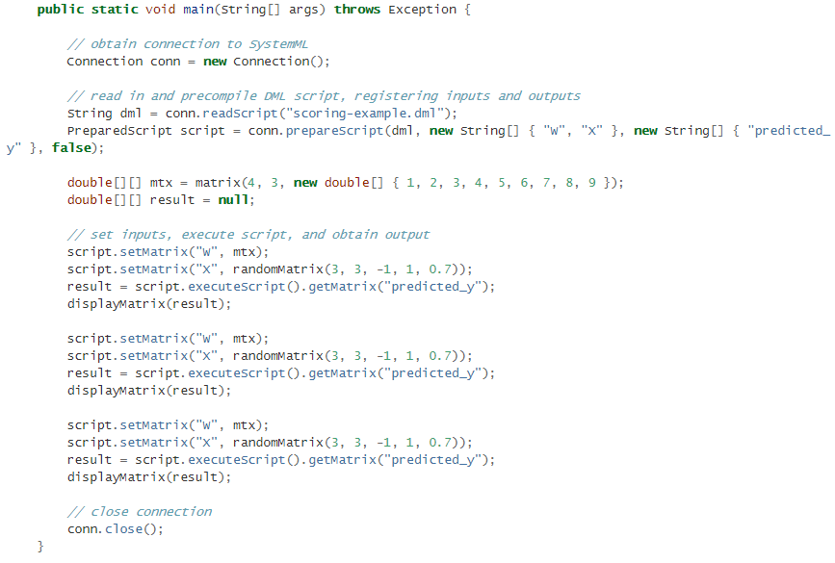
Invoking SystemML
Data on disk
In-memory single node
Hadoop
Spark
RDD/Dataframe/NumPy/SciPy
Also, Python MLContext API
double [] []
JMLC API
https://apache.github.io/systemml/jmlc
Especially useful for scoring and embeddable application
20

Slide 21
DEMO
21

